Slide 1

Brain Tumour Detector
Mentor : Sh. Piyush Gupta Sir
Vivek (19001011068)
Yashpal Sorout (19001011071)
B.Tech IT 5th Sem

Slide 2

Technologies used :
➢ Python: Python was the language of selection for this project. This was a straightforward call for many reasons.
Python as a language has a vast community behind it. Any problems which may be faced is simply resolved with a visit to Stack Overflow.
Python has an abundance of powerful tools prepared for scientific computing Packages like NumPy, Pandas and SciPy area unit freely available and well documented.
Python as a language is forgiving and permits for program that appear as if pseudo code.
➢ Jupiter Notebook: The Jupyter Notebook is an open-source web application that enables you to make and share documents that contain live code, equations, visualizations and narrative text. Uses include: data cleaning and transformation, numerical simulation, statistical modelling, data visualization, machine learning, and much more.

Slide 3
➢ Noise Removal and Sharpening: Unwanted data of element are remove using filter and image Can be sharpen and black and white gray scale image is used as a input.
➢ Erosion and Dilation: It is applied to binary image, but there are many versions so that can be work on grayscale images. The basic effect of the operator on a binary image is eroding away to the boundaries of regions for ground pixels.
➢ Negation: A negative is an image, usually it used on a strip or sheet of transparent plastic film, in negation the lightest areas of the photographed subject appear darkest and the darkest areas appear lightest.
➢ Subtraction: Image subtraction process is the digital numeric value of one pixel or whole image is subtracted from another image. The white part of tumor can be subtracted from another remaining part that is the black portion of the images.
➢ Threshold: Thresholding is a process of image segmentation. It converts the gray scale image into binary image.
➢ Boundary Detection: Total area or boundary can be form properly using boundary detection method. White part of tumor tissues can be highlighted and there proper boundary can be detected. It is useful method to calculate the size and shape occupy by tumor tissues.

Slide 4
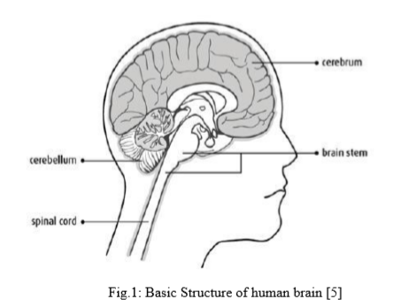
BRAIN TUMOUR DETECTION SYSTEM
The human body is made up of many organs and brain is the most critical and vital organ of them all. One of the common reasons for dysfunction of brain is brain tumor. A tumor is nothing but excess cells growing in an uncontrolled manner.

Slide 5
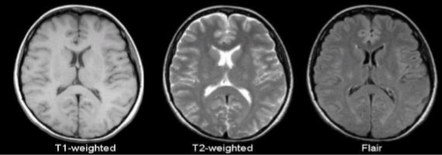
MAGNETIC RESONANCE IMAGING (MRI)
Raymond v. Damadian invented the first magnetic image in 1969. In 1977 the first MRI image were invented for human body and the most perfect technique. MRI is good technique for knowing the brain tumor in human body. There are different images of MRI for mapping tumor induced Change including T1 weighted, T2 weighted and FLAIR (Fluid attenuated inversion recovery) weighted.

Slide 6
Objective
The main aim of the applications is tumor identification.
The main reason behind the development of this application is to provide proper treatment as soon as possible and protect the human life which is in danger.
This application is helpful to doctors as well as patient.
The manual identification is not so fast, more accurate and efficient for user. To overcome those problem this application is design.
To provide doctors good software to identify tumor and their causes.

Slide 7
Motivation
The main motivation behind Brain tumor detection is to not only detect tumor but it can also classify types of tumor. So it can be useful in cases such as we have to sure the tumor is positive or negative, it can detect tumor from image and return the result tumor is positive or not. This project deals with such a system, which uses computer, based procedures to detect tumor blocks and classify the type of tumor using Convolution Neural Network Algorithm for MRI images of different patients.

Slide 8
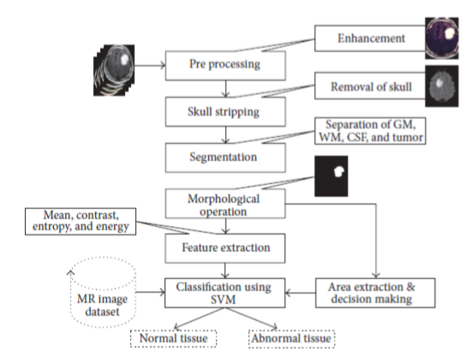
Exiting Work & Proposed Workflow

Slide 9
Image Preprocessing: As input for this system is MRI, scanned image and it contain noise. Therefore, our first aim is to remove noise from input image. As explained in system flow we are using high pass filter for noise removal and preprocessing.
Segmentation: Region growing is the simple region-based image segmentation technique. It is also classified as a pixel based image segmentation technique since it is involve the selection of initial seed points.
Morphological operation: The morphological operation is used for the extraction of boundary areas of the brain images. This operation is only rearranging the relative order of pixel value, not mathematical value, so it is suitable for only binary images.

Slide 10
Feature Extraction: The feature extraction is used for edge detection of the images. It is the process of collecting higher level information of image such as shape, texture, color, and contrast.
Connected component labeling: After recognizing connected components of an image, every set of connected pixels having same gray-level values are assigned the same unique region label.
Tumor Identification: In this phase, we are having dataset previously collected brain MRIs from which we are extracting features. Knowledge base is created for comparison.

Slide 11
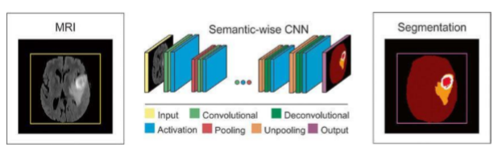
Working of CNN Model

Slide 12
Layer of CNN model:
Convolution 2D
MAX Poolig2D
Dropout
Flatten
Dense
Activation
Convolution 2D: In the Convolution 2D extract the featured from input image. It given the output in matrix form.
MAX Poolig2D: In the MAX polling 2D it take the largest element from rectified feature map.

Slide 13
Dropout: Dropout is randomly selected neurons are ignored during training. Flatten: Flatten feed output into fully connected layer. It gives data in list form. Dense: A Linear operation in which every input is connected to every output by weight. It followed by nonlinear activation function.

Slide 14
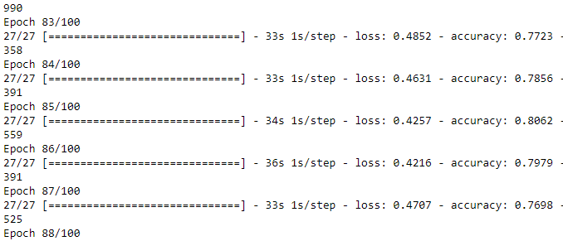
Train Data

Slide 15
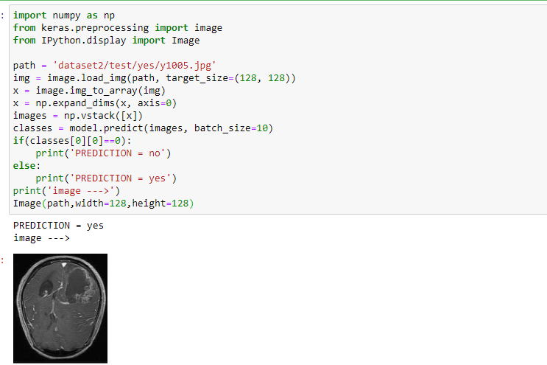
Prediction

Slide 16
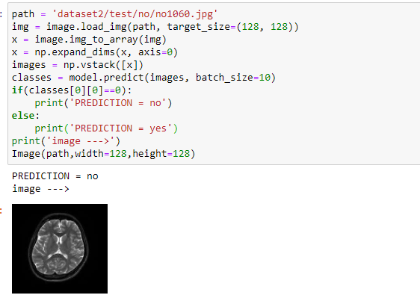
Prediction

Slide 17
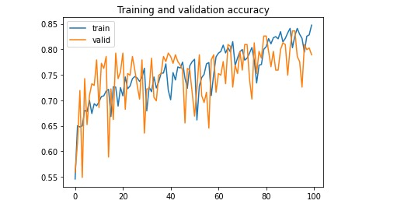
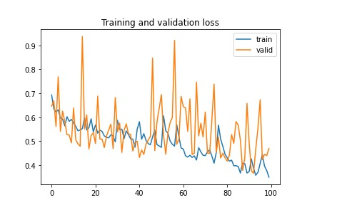

Slide 18
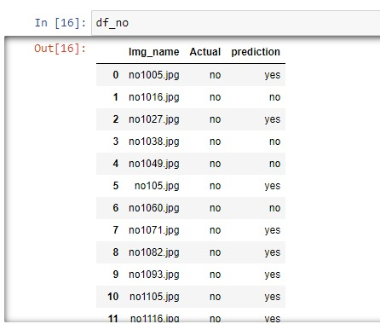
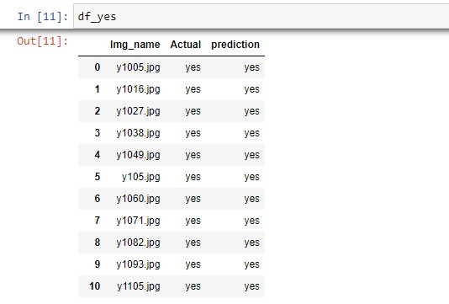

Slide 19
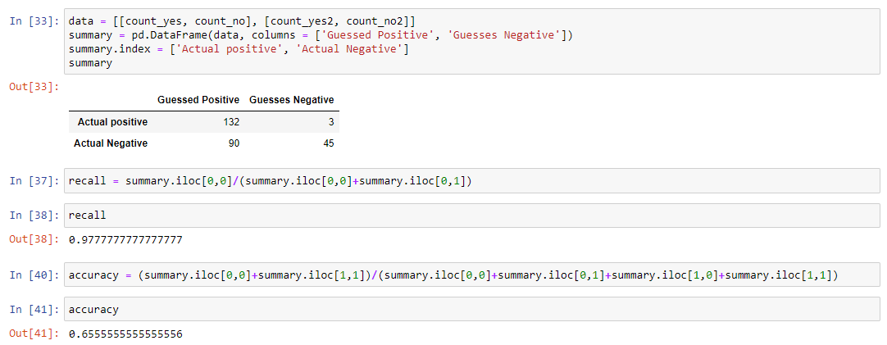
Recall and Accuracy

Slide 20
THANK YOU

